Slide 1



GROUP 9
HOSPITAL
MANAGER SYSTEM
Covenience solution for hospital

Slide 2

Contents
01.
Introduction
02.
Reasons
03.
Database diagrams
Schema Diagram
ER Diagram
04.
Structure
05.
Demo
06.
Conclusion

Slide 3




About
Us
Nguyễn Quý Minh
Nguyễn Đăng Phi Long
Leader
Code (Modules, GUI)
Manipulation with database
Database design
Powerpoint
Đỗ Chí Nghĩa
Nguyễn Quang Khải
Report

Slide 4

PROBLEMS OF CONVETIONAL SYSTEM
01.
02.
03.
Unresponsive
Inconvenience
Risky
Lack of immediate retrievals and prompt updating
Lack of immediate information storage
Error prone manual calculation

Slide 5

Advantages
- Immediate Access of data
- Friendly user interface
- Time saving
- Data can be easily insert/update/delete
- Saving paper work
- Give facility of different types of Enquiry
Of Computerized Hospital Manager System
- Data’s are easily approachable

Slide 6
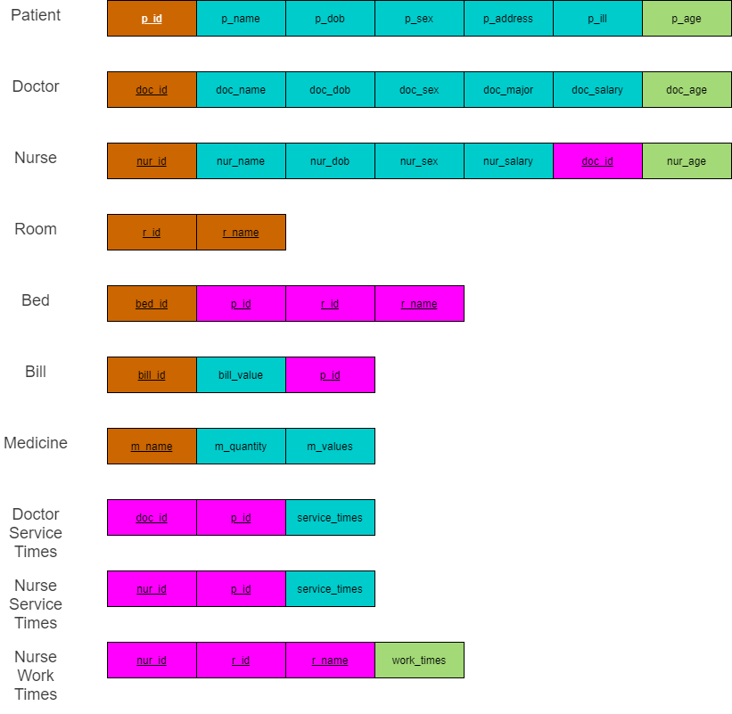
DATA BASE
Schema
Diagram

Slide 7
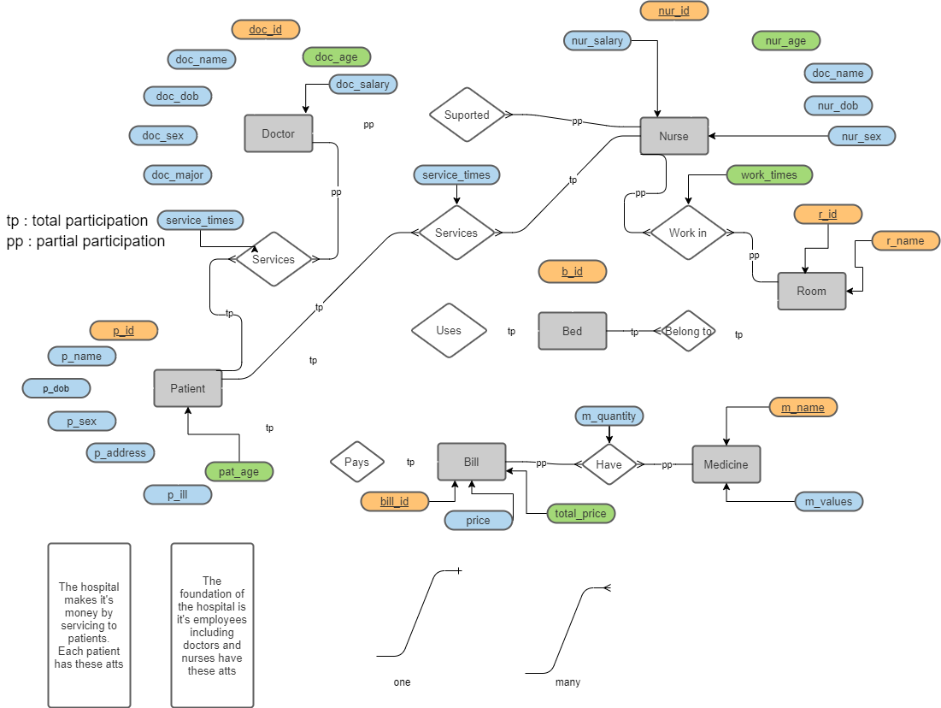
ER Diagrams

Slide 8
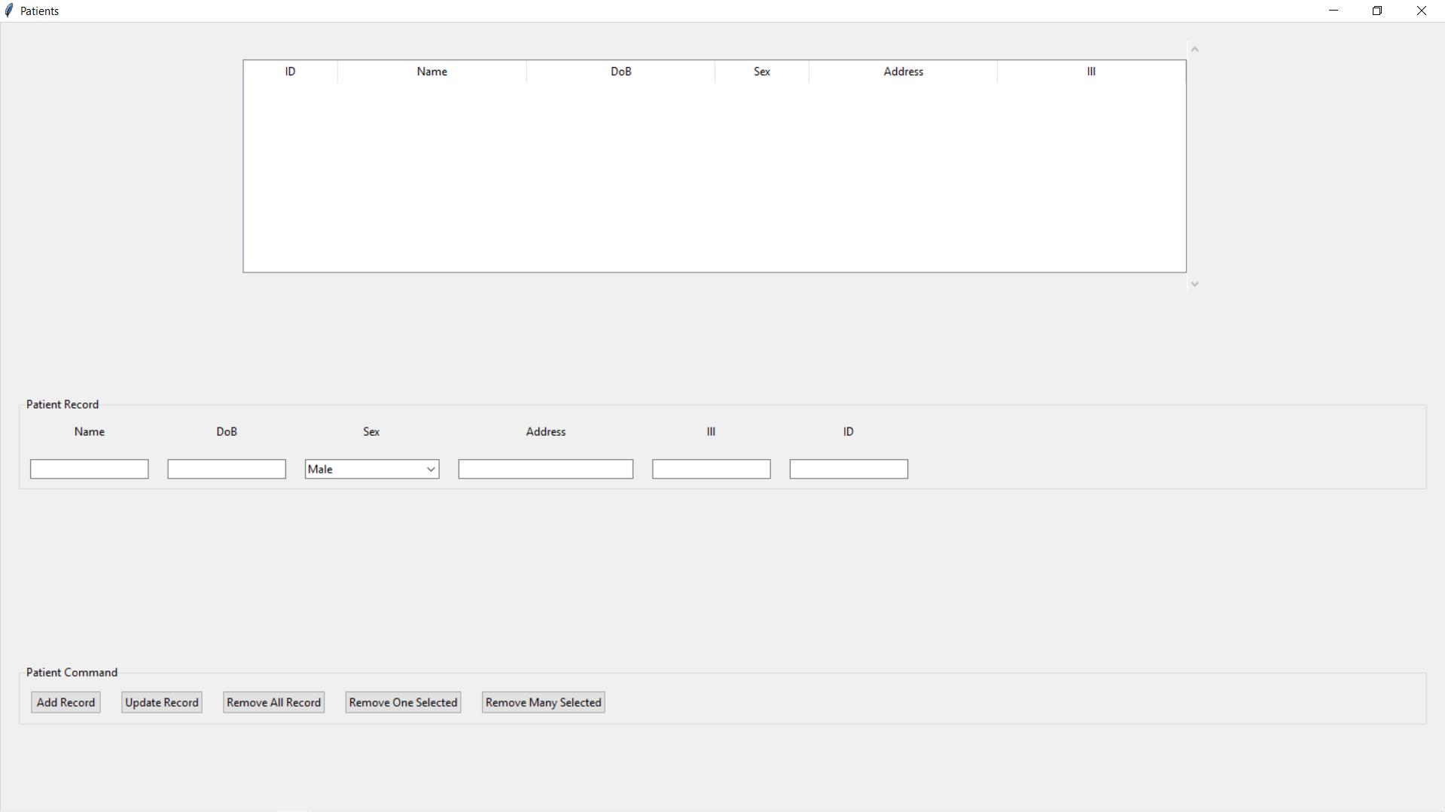
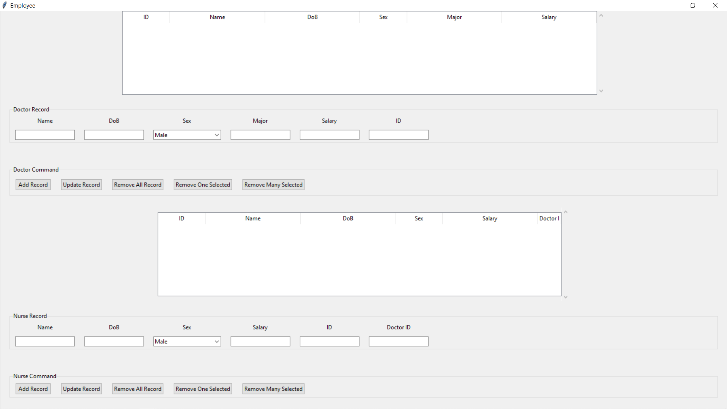
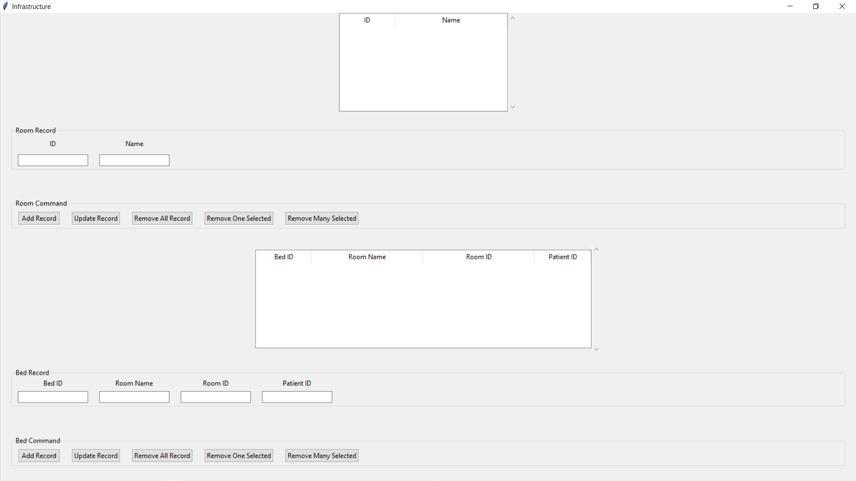
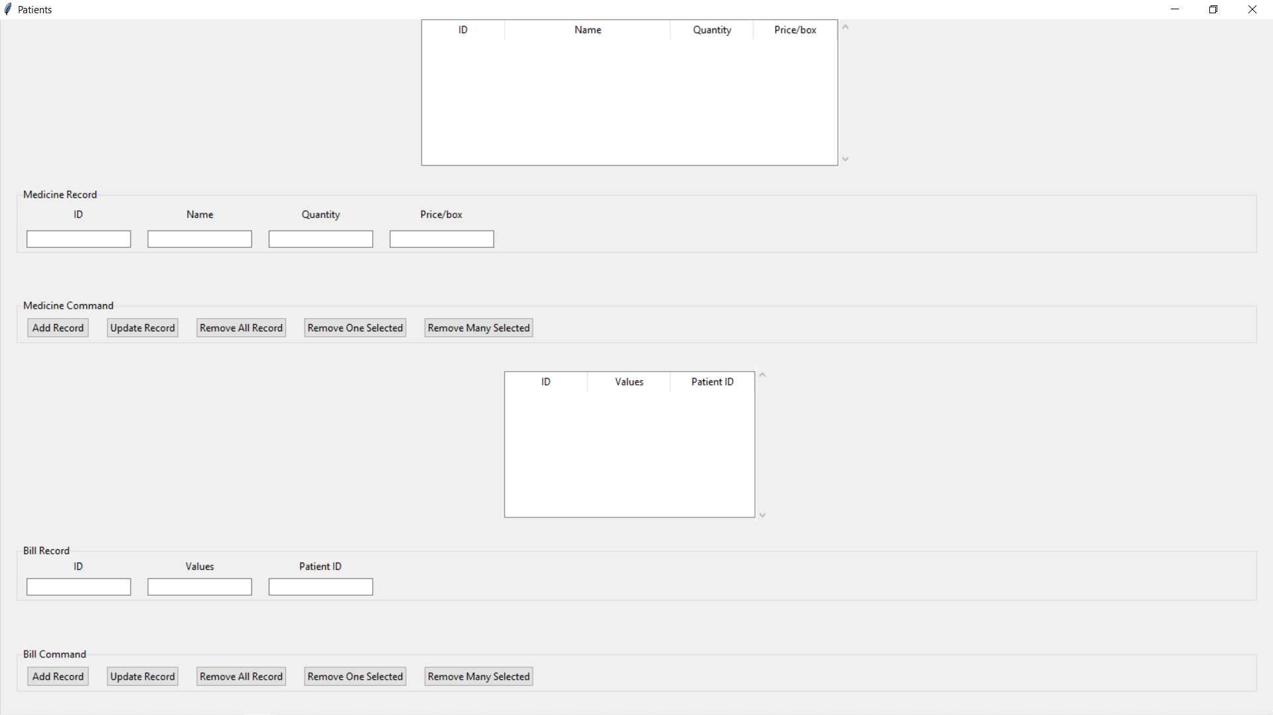
STRUCTURE
Patient
Employees
Infrastructure
Medicine and Bill

Slide 9
DEMO

Slide 10
NOT DONE..
- Derived values
- Remove_many

Slide 11
Thanks !

